Slide 1

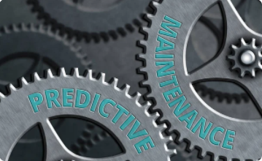
Predicting Maintenance
Team – Group 5

Slide 2
Business Problem:-
To create a model to predict when the machine is more likely to fail.
Business Objective:-
In industries, re-evaluating their maintenance schedules is necessary
for this digitalization era as smart as possible for production
enhancements. Predictive maintenance offers great opportunities to businesses for a smarter and more digital facility. Using this dataset
our objective is to predict when the machine is more likely to fail.

Slide 3
Project Architecture / Project Flow
01
03
EDA
Model Building
Insights from Numeric and Categorical Features
Missing Values
Outliers
Scaling the Data
Converting Categorical features to Numeric features
Balancing the Data
Logistic Regression
SVM
Decision Tree
RF Classifier
Boosting Technique
KNN
Deployment
Features Selection
Correlation
K-Neighbors
Chi-square
Feature Importnace (Extra Tree Classifier)
Flask
+
Heroku
04
02

Slide 4
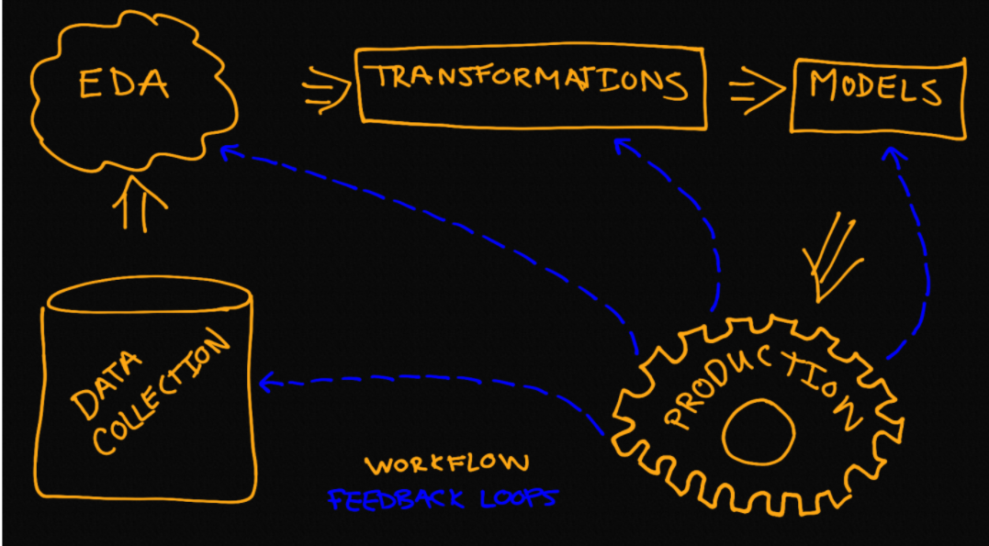

Slide 5
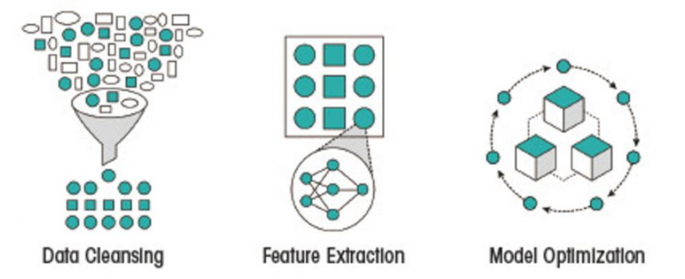

Slide 6
Variable View -
Features | Details
UID | unique identifier ranging from 1 to 10000
product ID | L, M, or H for low (50% of all products), medium (30%) and high (20%)
air temperature [K]: | Temperature of air in surrounding of machine
process temperature [K]: | Temperature of machine during process
rotational speed [rpm]: | Rotational speed within specific time
torque [Nm]: | Tendency of Force
tool wear [min]: | Gradual corrosion of cutting tool
Machine failure | Machine Fail =1, Machine Not Fail =0
TWF | Tool Wear Failure
HDF | Heat Dissipation Failure
PWF | Power Failure
OSF | Over Strain Failure
RNF | Random Failure

Slide 7
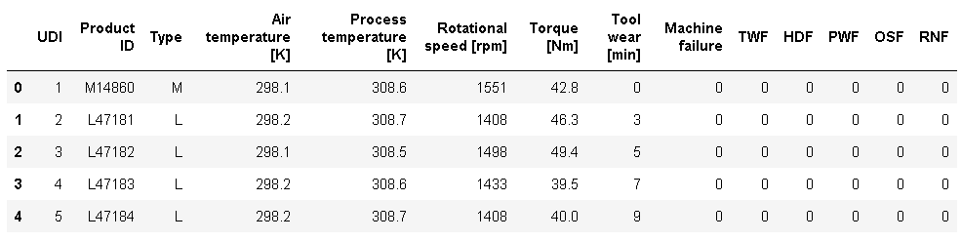
Features View in Jupyter Notebook -

Slide 8
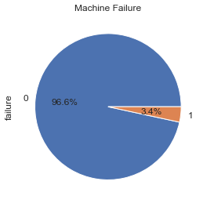
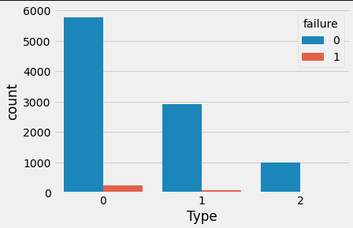
Exploratory data analysis -
Machine Failure are only 3.4%. Therefore Data is Imbalance.
Low Quality is having more Failure
as compared to medium and high

Slide 9
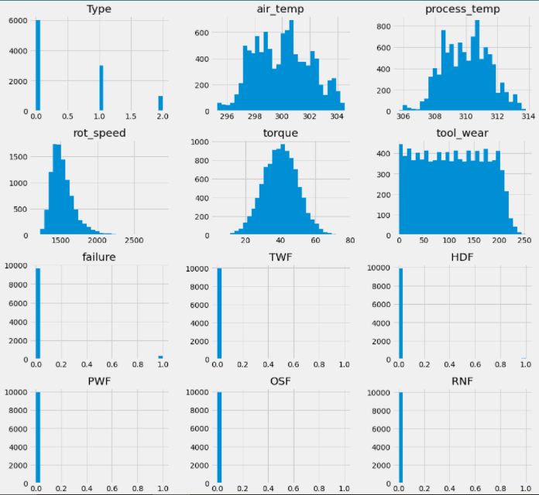
Histogram of each Feature -

Slide 10
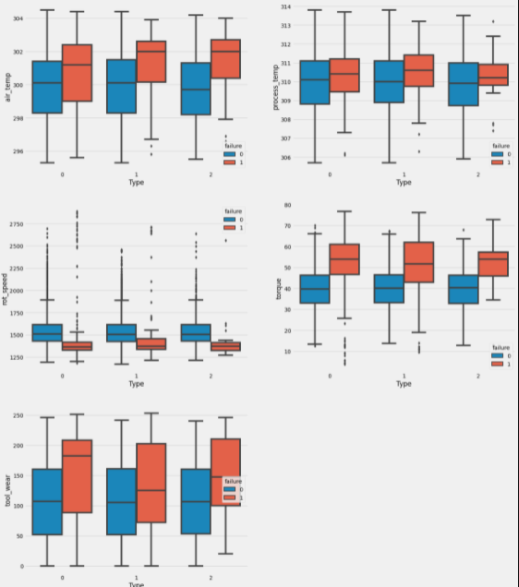
Outliers Detection-

Slide 11

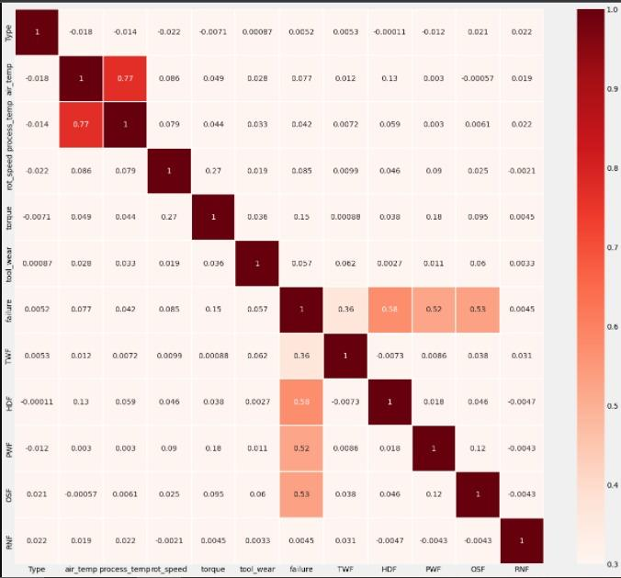
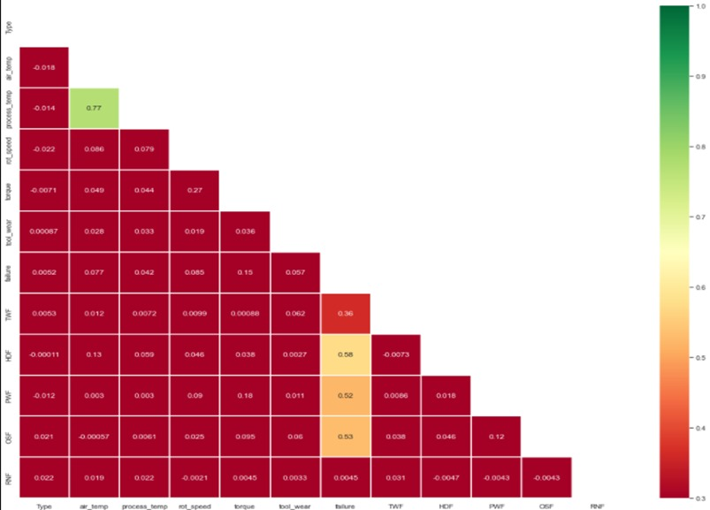
Correlation Between Features -
High Correlation between
air temperature [K]: & process temperature [K]:

Slide 12
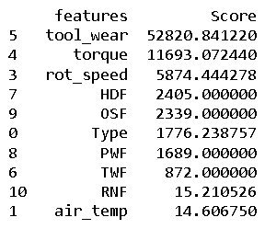
Feature Selection Using Chi-square :
From Chi-square feature selection the important feature are:
5 (tool_wear) ,4 (torque),3 (rot_speed),7 (HDF) & 9 (OSF).

Slide 13
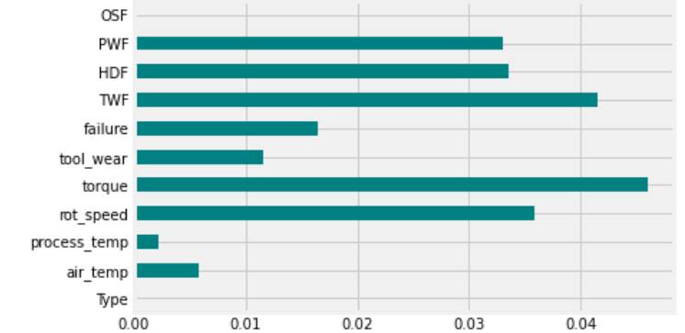
Filter methods :
From Filter Method the important features are :
Torque, TWF, rot_speed,HDF & PWF

Slide 14

Feature Importance using Extra Trees Classifier :
From Feature Importance using extra tree classifier we can conclude that–
Torque , Rotational_speed, PWF, OSF, Tool_wear & HDF features are more important for prediction

Slide 15

Feature Extraction with RFE :
By RFE ( Recursive Feature Elimination ) we got important feature:
Type- Air temp, process temp, TWF, HDF, PWF, OSF, & RNF as the best features.

Slide 16
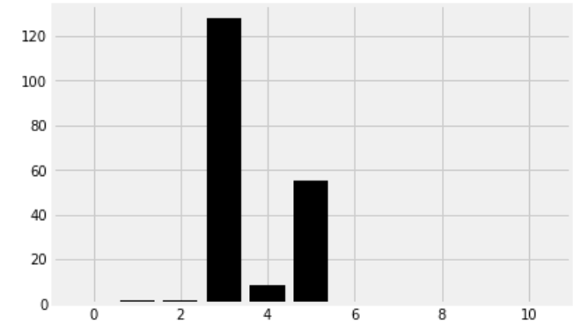
Mean Absolute Difference (MAD) :
For mean Absolute Difference (MAD)
the important feature are:
( Rotational speed ), (torque) & (toolware)

Slide 17



Wrapper Method Feature Selection :
Forward feature selection :
From Wrapper method Feature selection :
From Forward feature selection, Backward feature selection & Exhaustive feature selection the important feature are:
2 (process temperature),3 (rotational speed),6 (tool_wear), 7 (TWF) ,8 (HDF), 9 (PWF) &10 (OSF)
Backward Feature Selection :
Exhaustive Feature Selection :

Slide 18
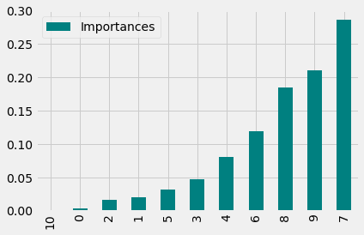
Feature selection using Random Forest Classifier
Embedded Methods for Feature Selection :
From Random Forest Classifier feature selection the important feature are:
TWF, PWF, HDF, tool_wear,
torque

Slide 19
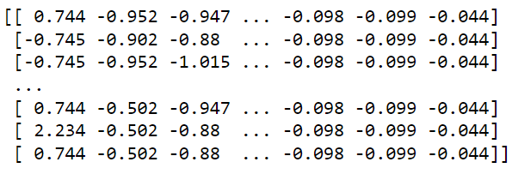
Standarizing the Data using StandardScaler:

Slide 20
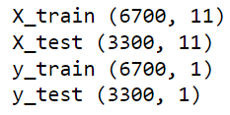
Splitting Data into Train & Test:

Slide 21
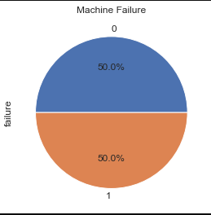
Balancing the Data using SMOTETomek from imblearn library :
Original Data-
After Balancing Data-

Slide 22
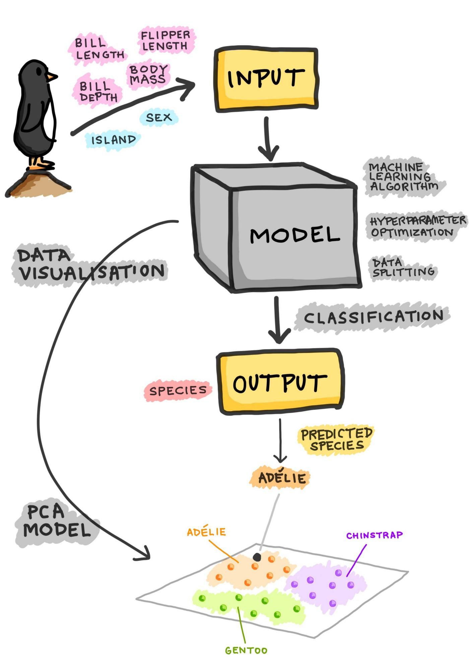
Model Building

Slide 23
Logistic Regression :
Imbalanced
Balanced
Train data
Train data
.
.
Test data
.
Test data
.

Slide 24
SVM :
Imbalanced
Balanced
Train data
Train data
.
.
Test data
.
Test data
.

Slide 25
Decision Tree :
Imbalanced
Balanced
Train data
Train data
.
.
Test data
.
Test data
.

Slide 26
Random Forest Classifier :
Imbalanced
Balanced
Train data
Train data
.
.
Test data
.
Test data
.

Slide 27
AdaBoost Performance :
Balanced
Imbalanced
Accuracy :-
Accuracy :-
.
.

Slide 28
Gradient Performance :
Imbalanced
Balanced
Accuracy :-
Accuracy :-
.
.

Slide 29
Extreme Gradient Boost Performance :
Imbalanced
Balanced
Accuracy :-
Accuracy :-
.
.

Slide 30
LGBM Performance :
Balanced
Imbalanced
Accuracy :-
Accuracy :-
.
.

Slide 31
KNN :
Imbalanced
Balanced
.
.
Accuracy :-
Accuracy :-

Slide 32
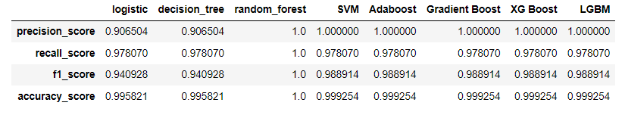
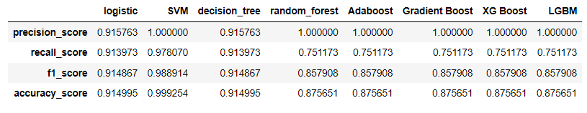
Model on Imbalanced data :-
Model on Balanced data :-

Slide 33
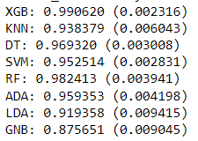
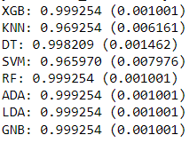
Voting Classifier :
Imbalanced
Balanced

Slide 34
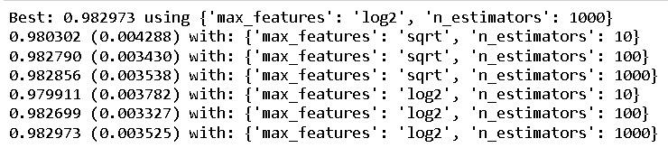
Hyper Parameter Tuning :
Random Forest Classifier (Balanced) :-

Slide 35

Model Deployment

Slide 36
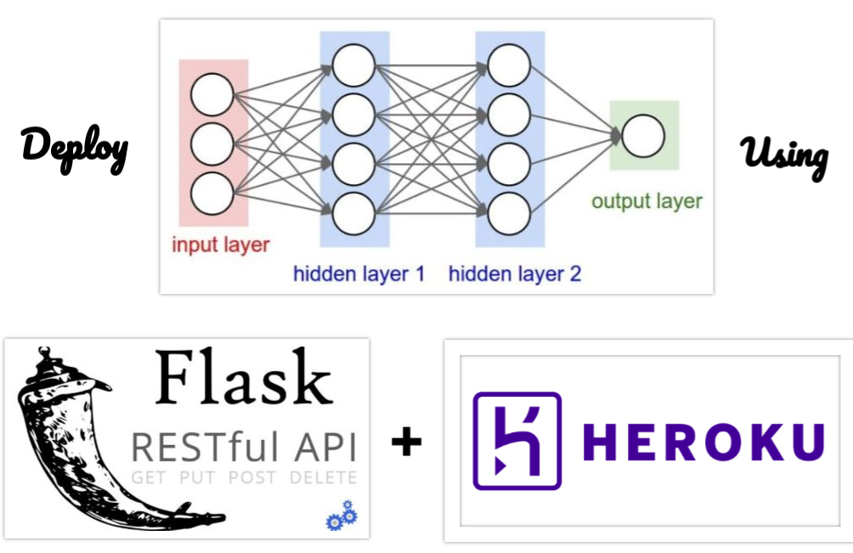

Slide 37
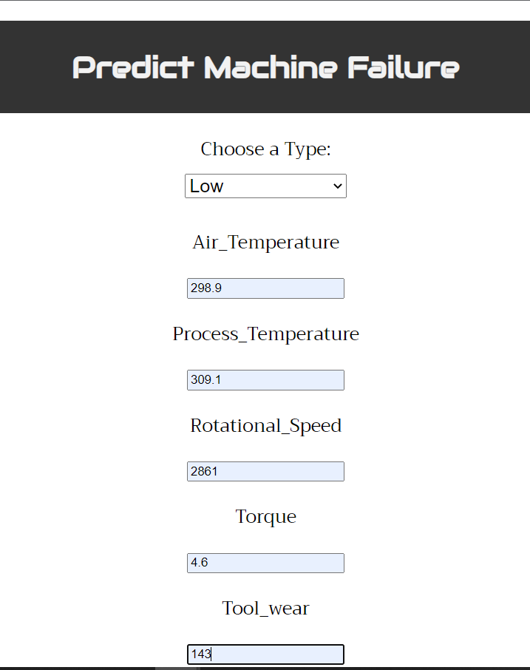
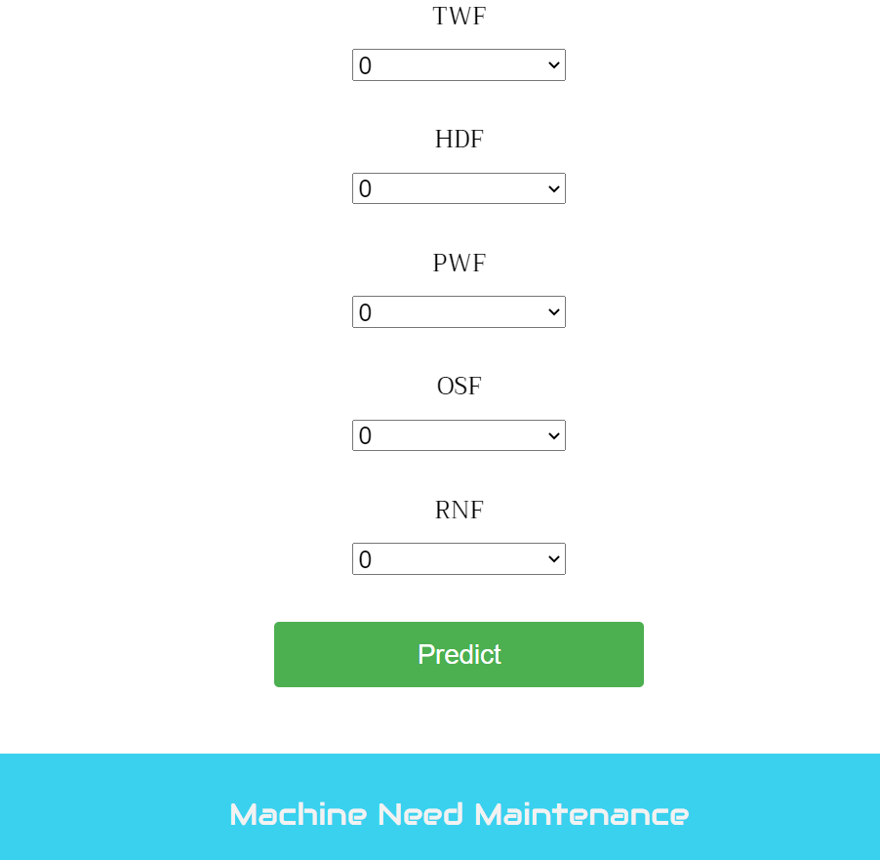
User Interface
By Giving inputs the user can predict whether the machine needs maintenance or not.

Slide 38
Web application Link -
https://deploypredicting.herokuapp.com/

Slide 39


Slide 40
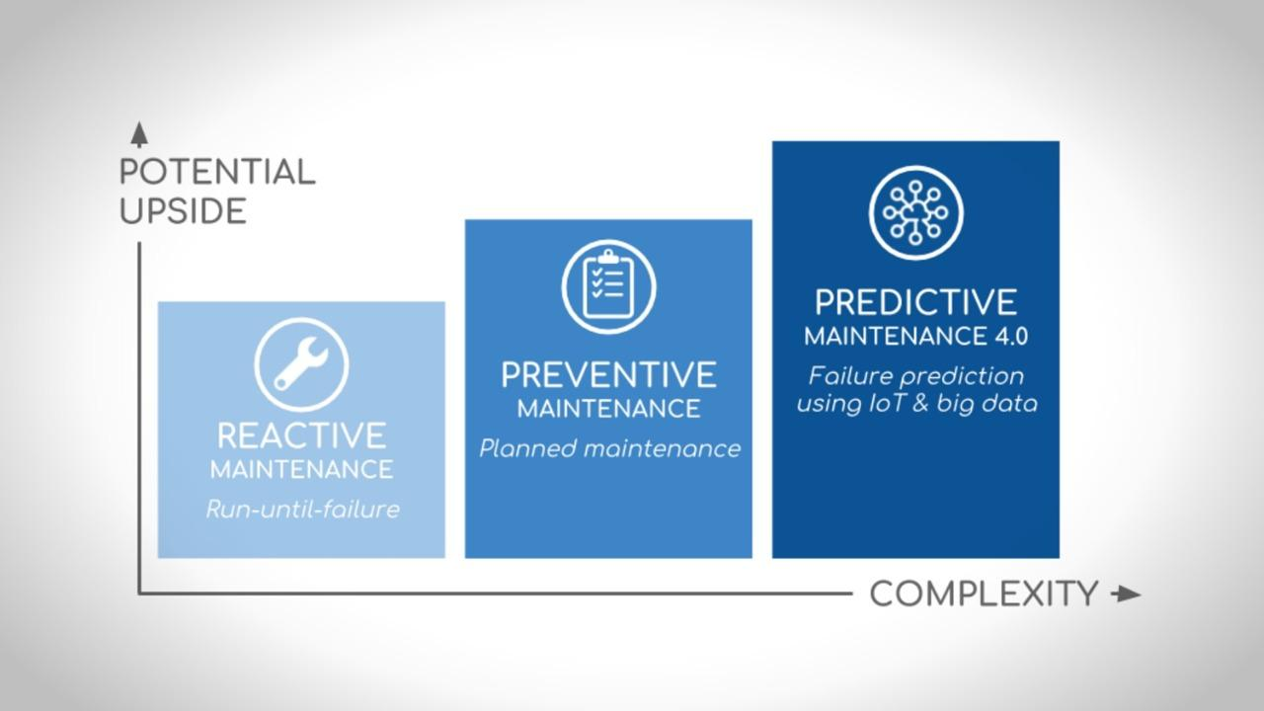

Slide 41
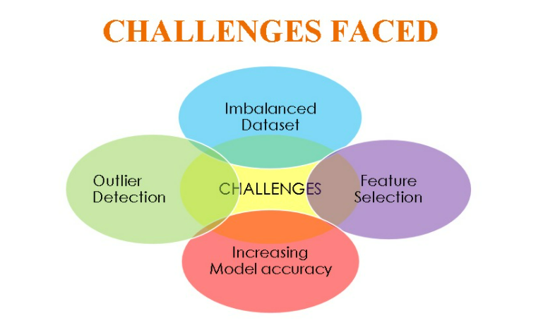

Slide 42

It is possible to have a successful preventive maintenance program.
From a cost reduction viewpoint it is essential, but it does entail risk.
When the proper care is taken, the risks, however, can be minimized.
In order to minimize risk, preventive maintenance has to be carefully planned and carried out by well-trained and motivated workers.
The biggest benefits of a Predictive Maintenance program occur through painting, lubrication, cleaning and adjusting, and minor component replacement to extend the life of equipment and facilities..

Slide 43



